Slide 1
Framework and Data Model for OTN Network Slicing
draft-ietf-ccamp-yang-otn-slicing-02
Co-authors:
Aihua Guo (Futurewei)
Sergio Belotti (Nokia)
Reza Rokui (Ciena)
Luis M. Contreras (Telefonica)
Yunbin Xu (CAICT)
Yang Zhao (China Mobile)
Xufeng Liu (IBM Corporation)
Contributors:
Haomian Zheng (Huawei)
Italo Busi (Huawei)
Victor Lopez(Nokia)
Dieter Beller (Nokia)
Oscar Gonzales (Telefonica)
Henry Yu (Huawei)
Jiang Sun (China Mobile)

Slide 2
Updates Since IETF 113
Text Updates
Added a section to describe OTN slice realization with NRP (Network Resource Partition)
Other cosmetic updates
YANG Model Updates
NBI: Updated ietf-transport-network-slice.yang by augmenting the model defined in draft-ietf-teas-ietf-network-slice-nbi-yang-02
MPI: Renamed “ietf-otn-slice” to “ietf-otn-slice-mpi”
“ietf-otn-slice” is reserved for the NBI model
ietf-otn-slice
augments
This draft
ietf-transport-network-slice
augments
draft-ietf-teas-network-slice-nbi
ietf-network-slice-service
NBI model

Slide 3
Use of NRP for OTN Slicing
NRP can be used to address scalability issues mostly occurred in packet networks and to reduce complexity in the realization of slices
NRP is internal construct to a network slice controller, but may be configured on the underlying SDN controller through MPI to facilitate the slice realization
For OTN and other transport networks (MW, L0, etc.) resources are much coarse granular
Use of NRP is optional but still has its benefits for e.g. resource-based slicing
Evolving OTN data plane technologies may face similar scalability issues.
E.g. sub-1G OTN

Slide 4
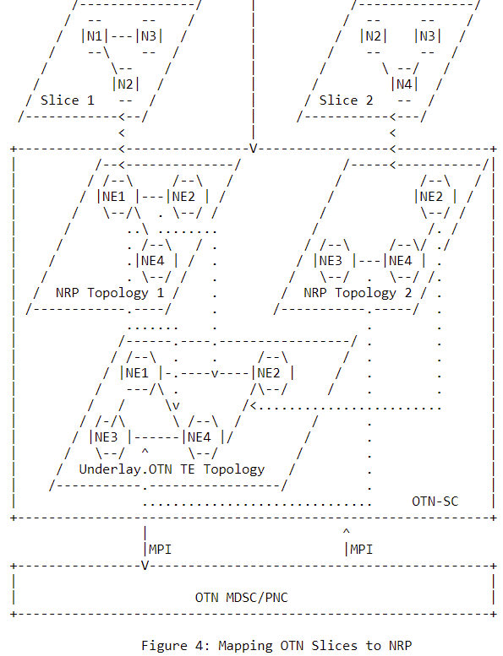
Realizing OTN Slices with NRP
For connectivity-based OTN slices, a connection within an OTN slice can be realized by an OTN tunnel in the underlay topology. Resources are reserved by the tunnel, thus use of NRP is optional in this case.
For resource-based OTN slices, the OTN-SC may choose to map an OTN slice directly onto the underlay TE topology
An underlay topology is an abstracted topology exposed by the underlying MDSC/PNC and may not be a “native” OTN topology
Resources need to be colored in the underlay topology
A connection created within the slice needs to be specified with colors
Alternatively, the OTN-SC can create NRP topologies for resource reservation.
OTN slice topology: NRP topology = 1: 1
No need for coloring
NRP topologies are configured on subtended MDSC/PNC through the MPI

Slide 5
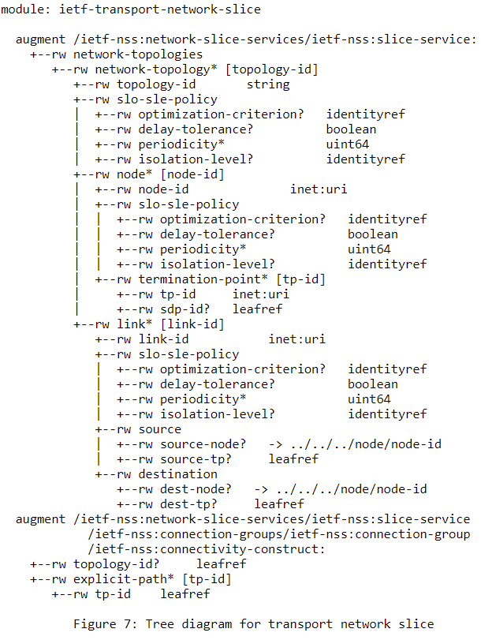
YANG Model Updates
ietf-transport-network-slice.yang now augments ietf-network-slice-services.yang
Added list of network topologies to support resource-based slicing
Introduced common SLO grouping for slices with transport network technologies
Added path references to each connectivity construct of a slice

Slide 6
Open Issue: How to define technology-specific attributes?
Opaque vs. explicit definition of attributes for e.g. SLO/SLE
Is it the best way using opaque definition of (key, value) pairs to define technology-specific attributes?
Implementation agreements are required in addition to the YANG model to avoid interoperability problem
May not capture complex attribute structures
Unable to be auto/explicitly validated with YANG
For OTN Slicing our preference is to define explicit, technology-specific attributes and not use the opaque definition

Slide 7
Open Issue: Defining multiple MPI Interface Models?
OTN-SC is flexible in choosing different MPI interfaces for realizing a slice. Use of NRP is optional.
Is it necessary for a standard draft to include multiple optional MPI models? Currently,
ietf-otn-slice-mpi.yang uses coloring
New MPI model is needed if using NRP
Augments the TE topology model (RFC8795) with new topology type = NRP

Slide 8
Next Steps
Address open issues
Continue working with draft-ietf-teas-ietf-network-slice-nbi-yang-02 to align the two models
Define OTN technology-specific model based on ietf-transport-network-slice (which augments ietf-network-slice-service)
Technology-specific SLO/SLE for OTN
Support both connection-based and resource-based slicing
Support multi technology links (non-OTN access links and OTN links)
* GitHub Repo
https://github.com/ietf-ccamp-wg/ietf-ccamp-yang-otn-slicing
* CCAMP Weekly Call: Thu 10-11am EST
https://mailarchive.ietf.org/arch/msg/ccamp/Dr3HWPlmP9LyA6NmabWJvx7hWIc/

Slide 9
Thank You!

